Slide 1
Clinical Protocol RAG
Applicability-aware clinical recommendation prototype
Presented by
Presented to
Saif Ahmed
Session: 2020-21
Dept of Computer Science and Engineering
Sylhet Engineering College
Sylhet.
Admin, HEAT Sub-Project PIN #13863
United International University
Dhaka-1212, Bangladesh
Notes:
[object Object],[object Object]

Slide 2
Clinical Protocol RAG
Applicability-aware clinical recommendation prototype
4 clinical protocols
17 canonical cards
2 runnable modes
6 frozen cases
12 saved outputs
Goal
Given patient symptoms and available context, retrieve protocol evidence and produce a probable diagnosis, investigations, medication planning, advice, and explicit missing-information handling.
Interview presentation • prototype + experiment + paper discussion
Notes:
[object Object],[object Object]

Slide 3
From protocols to retrievable clinical knowledge
Dengue
Hypertension
Cholera
Chikungunya
Diagnosis • warning signs
Investigations • management
Confirmation • investigations
Primary-care management
Dehydration assessment
Plan A/B/C • antibiotics
Presentation • testing
Supportive management
Canonical JSON/JSONL
Evidence fidelity
RAG index
Card ID
Disease + clinical category
Prerequisites / exclusions
Recommended action
Medication details where supported
Source title + version
PDF page
Supporting passage
No guessed medication fields
all-MiniLM-L6-v2 embeddings
FAISS IndexFlatIP
Metadata retained for traceability
Notes:
[object Object],[object Object]

Slide 4
Baseline vs. tested improvement
Baseline
Patient input
Semantic retrieval
Top-k cards
Recommendation
No prerequisite check
Similarity only
Improved
Primary context
Applicability
Missing info
Recommendation
Patient input
Semantic retrieval
Prerequisites + exclusions
Block unsafe guessing
Disease focus
Tested improvement = primary context + applicability + missing-information checks
Notes:
[object Object],[object Object]

Slide 5
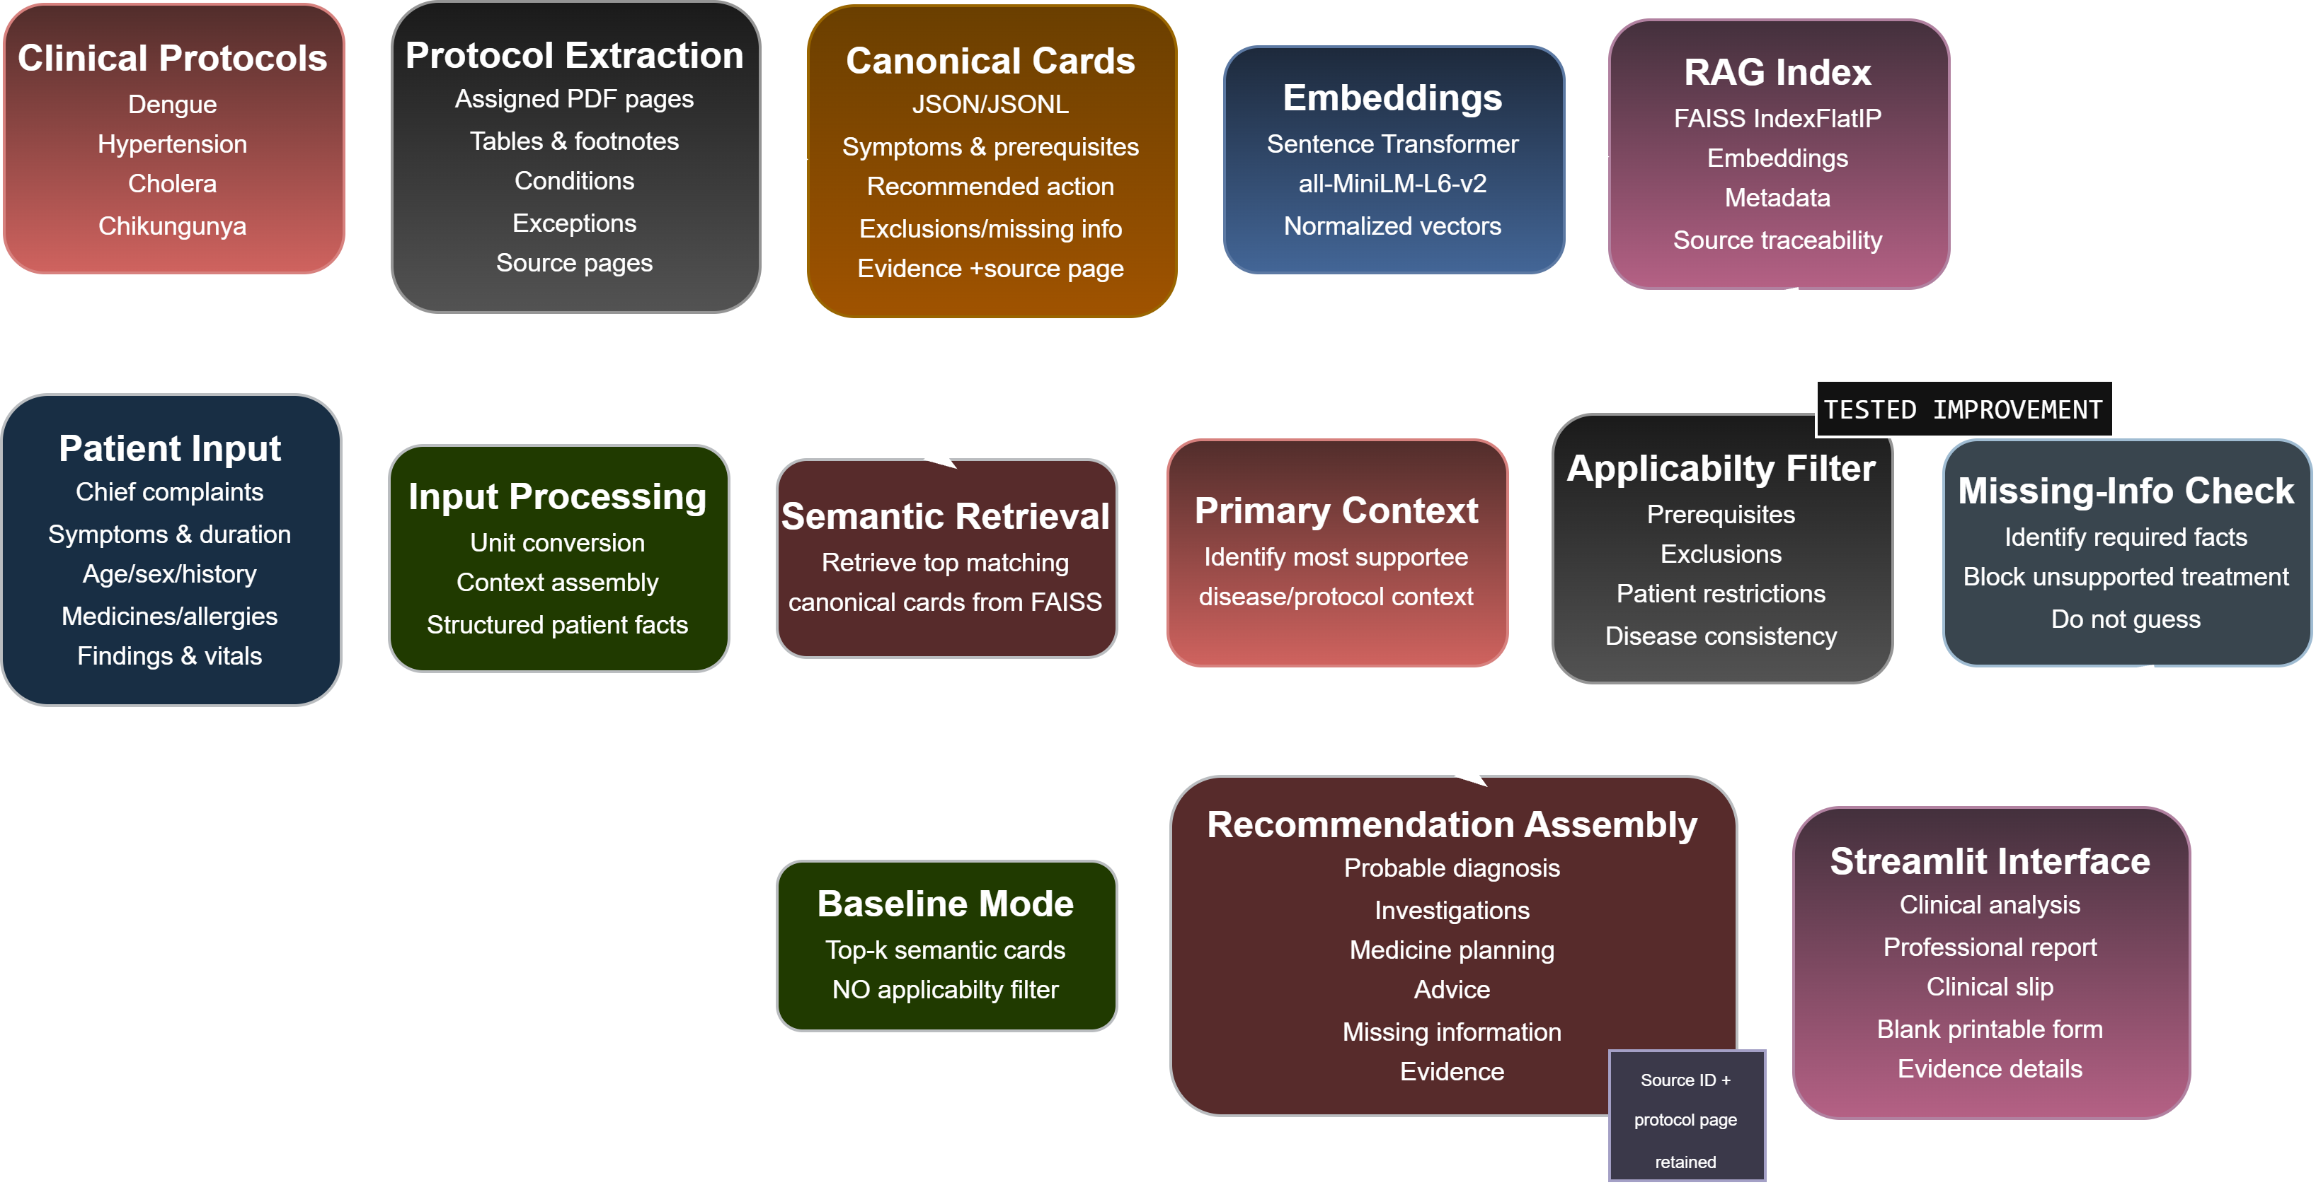
System architecture
Future: NER input • doctor acceptance/feedback • clinician-approved prescription assembly
Notes:
[object Object],[object Object]

Slide 6
Demo: why applicability matters
Same disease context, one added prerequisite changes the management pathway.
Case 05 — Incomplete Cholera
Improved response
35-year-old
Acute watery diarrhoea
No dehydration severity provided
Diagnosis + assessment retained
Severity-dependent treatment blocked
Missing information stated explicitly
Case 06 — Modified
Improved response
Same presentation +
weak pulse • sunken eyes
unable to drink • severe dehydration
Severe dehydration detected
Plan C becomes applicable
Plan A / B remain blocked
Notes:
[object Object],[object Object]

Slide 7
Evaluation on six frozen fictional cases
Four predefined checks per output; 12 outputs total.
Predefined checks
Latency
Expected behavior occurred
Recommendations supported by citations
Relevant restrictions preserved
Missing information handled without guessing
24/24
Baseline avg: 0.0469 s
Improved avg: 0.0279 s
100%
16/24
66.67%
Where baseline failed
Cholera: incompatible treatment plans
Incomplete case: treatment despite missing severity
Chikungunya: cross-disease retrieval leakage
Baseline
Improved
24/24 = predefined safety-and-behavior checks on six self-authored cases — NOT clinical accuracy or independent validation.
Notes:
[object Object],[object Object]

Slide 8
Related paper: multimodal AMIE (Saab et al., 2026)
Research problem
Design
Evaluation
Result
Text-only diagnostic dialogue misses images, ECGs, and clinical documents used in real care.
Multimodal AMIE + state-aware dialogue phases that update patient state, DDx, and knowledge gaps.
Randomized, blinded exploratory OSCE-style study with 105 simulated telehealth consultations.
Higher performance on 29/32 assessed axes; 7/9 multimodal-reasoning metrics.
What I adopt
Bangladesh GP transfer limitation
Maintain an evolving patient state
Make knowledge gaps explicit
Use new evidence to refine recommendations
Simulated telehealth, not real Bangladesh primary care
Local prevalence, language and resource constraints differ
Full multimodal infrastructure exceeds this assessment scope
Source: Saab et al., Nature Medicine 32, 1726–1736 (2026) • DOI: 10.1038/s41591-026-04371-0
Notes:
[object Object],[object Object]

Slide 9
Takeaways, limitations & next steps
What worked
Current limitations
Future integration
• Protocol evidence remained traceable
• Applicability rules reduced prerequisite errors
• Missing information was surfaced instead of guessed
• Same UI supports baseline and improved modes
• Only four protocols / 17 cards
• Six self-authored fictional cases
• No real clinician validation
• Rule coverage is intentionally narrow
• Local prototype timing only
• NER extraction from notes
• Doctor accept / reject / modify feedback
• Broader protocol coverage
• Blinded clinician review
• Clinician-approved prescription assembly
Core contribution
A small, auditable clinical RAG prototype that separates semantic relevance from patient-specific applicability before producing a recommendation.
Notes:
[object Object],[object Object]

Slide 10
Clinical Protocol RAG
Thank You
Notes:
[object Object],[object Object]

